Slide 1


We are surrounded by living and non-living things.
How can we distinguish the living things from the non-living things?

Slide 2
All living things are made up of one or more cells.
For example, an adult human body has about 10,000,000,000,000 cells!
Notes:
Note:
10,000,000,000,000 (10 trillion)

Slide 3
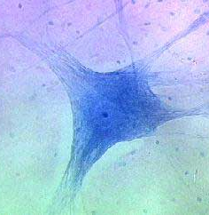
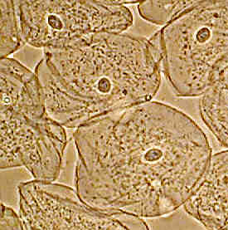
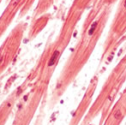
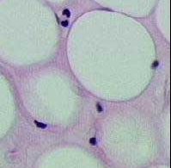
Nerve cell
We are different types of cells, managing our own lives, in this girl’s body.
Cheek cell
Muscle cell
Fat cell
Notes:
From top to bottom:
Nerve cell (in brain)
Cheek cell (or epithelial cell lining mouth)
Smooth muscle cell (in heart)
Fat cell (or adipose cell)
Note:
over 200 types of human cells in our human body
Photographs obtained from:
http://www.carolguze.com/text/102-19-tissuesorgansystems.shtml
http://missinglink.ucsf.edu/lm/IDS_101_histo_resource/nerves_muscle.html

Slide 4
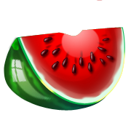



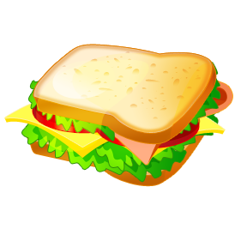
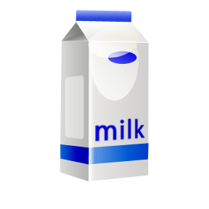
Our owner carries out activities, such as eating and drinking, to stay alive and grow.
To help her achieve this, we also need to stay alive and grow.
Thus, all of us also carry out the same activities, such as,
eating,
drinking, and well...
getting rid of waste.

Slide 5
But how can we do the same things, when we are so different?
That’s because many components inside us are the same.
Therefore, we are actually quite similar.
Huh???

Slide 6
Your challenge for the day!
Identify the activities that are carried out by the basic components of a cell.
Explain how these activities enable the cell to stay alive and grow.
Hence, explain why the same basic components are usually found in different types of cells.

